Slide 1



Data Insights for Change:
Preliminary research into Student Success in International District Schools
Ty
Notes:
Data Insights for Change: Supporting Student Success in the International District
Data-Driven Support: Exploring Factors Influencing Student Success in New Mexico Schools
Unlocking Potential: Analyzing Student Success Indicators in the International District
Beyond the Classroom: A Data Analysis of Attendance, Proficiency, and Student Attitudes
Empowering Education: Identifying Key Indicators for Student Success in After-School Programs
Mapping Success: A Data Exploration of Student Outcomes in the International District
The Path to Achievement: Analyzing Influences on Student Performance in Public Schools
Bridging Gaps: Understanding the Role of After-School Programs in Student Success
Indicators of Success: A Comprehensive Analysis of Student Performance Metrics
From Data to Action: Leveraging Public Data to Enhance Student Outcomes
Hello and welcome to our capstone presentation
I am Tyre’ Beard and my backgroun is in …..
I am Timothy McKee and my background is in….
And I’m Emily Walukas and my background is …..

Slide 2
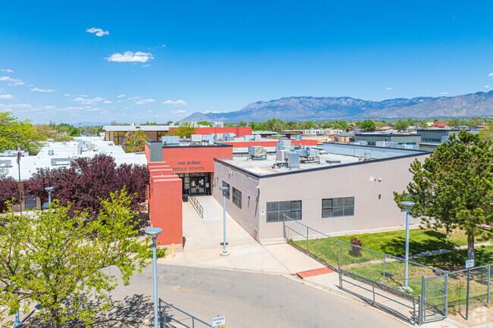

Goal and Collaborations
Ty
Focus Schools
Wherry Elementary
Emerson Elementary
Whittier Elementary
Wilson Middle
Van Buren Middle
Hayes Middle
Highland High
Van Buren Middle School
Our Goal: Use publicly available data to suggest effective ways to support students in Title I schools in International District in APS
Our Timeline: 12 week course ~5 weeks of dedicated capstone project time
Notes:
The New Mexico Black Leadership Council works with a subset of public schools in the International District, providing after-school programs in addition to other services. They’re interested in a broad set of indicators for student success, such as attendance, proficiency scores, and student attitudes, and the factors that may influence those indicators.
Our goal was to use publicly available data to explore ways that the NMBLC could best support students.
Title I of the Every Student Succeeds Act (ESSA) is the largest federal assistance program in our nation’s schools.
Schools must be identified at 50% (now 60% this year) or higher economically disadvantaged in order to receive Title I funds.
Each school has a team made up of administrators, staff, and parents (Instructional Council). This team determines program needs based on data from state and district testing. Title I programs are required to align with the school's 90-Day Plan.
The International is the area between San Mateo Boulevard, Lomas Boulevard, Wyoming Boulevard, and Gibson Boulevard.
What is international district
Why is NMBLC working with these schools

Slide 3
Data Analysis Process
Ti
Problem Definition
Understand the project's objectives from a business viewpoint.
Data Collection
Gather relevant data. If data are already available, understand how data were collected.
Data Cleaning & Exploratory Data Analysis
Understand, clean and explore data.
Processing
Use modeling techniques to gain useful insights into data and meet objectives of the project.
Communication of Results
Communicate results of analysis. Draw meaningful conclusions.
Notes:
Define Questions
Interesting and actionable for NMBLC
Data is available
Fits within available project time
Consult with Subject Matter Experts
NMBLC
NMPED Research, Evaluation and Accountability
APS Strategic Analysis & Program Research
Retrieve data
Direct requests to agencies for files
Download from agency portals
Manually
Web scraping
PDF Parsing
Organize and clean data
Nulls, multiple data types in single columns, non-numeric data
Contents and formatting of data different between years
Bring separate datasets into centralized datasets or analysis

Slide 4

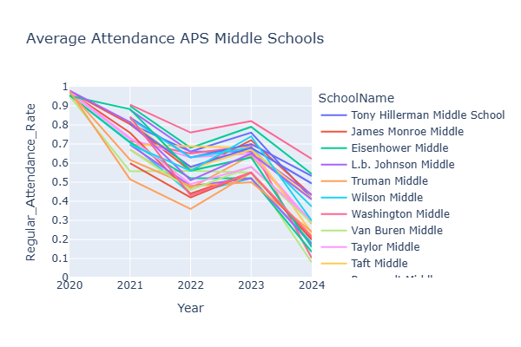




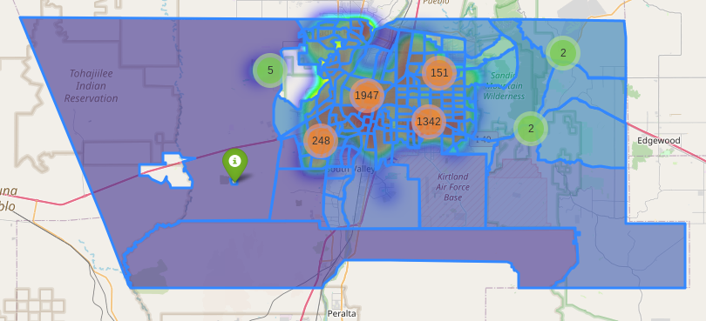



Scope of End Product
Ti
Data Sources
Data Formats
Tools used
End Products
Excel reports sent from agencies by request
CSV, Excel and PDF files downloaded from agency websites
Databases accessed via API
Python
Open-source libraries (Pandas, MatPlotLib, Seaborn, Plotly, SciKitLearn)
Google Colaboratory/Jupyter Notebooks
GitHub
Data Visualizations
Interactive Geographical Data Tool
Early Stage of a Predictive Model
Notes:
Data sourced from:
New Mexico Public Education Department
Albuquerque Public Schools
US Census Bureau
Data Formats:
Excel reports sent from agencies by request
CSV, Excel and PDF files downloaded from agency websites
Databases accessed via API
End Product:
Data Visualizations
Interactive Geographical Data Tool
Early Stage of a Predictive Model
Title I of the Every Student Succeeds Act (ESSA) is the largest federal assistance program in our nation’s schools.
Schools must be identified at 50% or higher economically disadvantaged in order to receive Title I funds.
Each school has a team made up of administrators, staff, and parents (Instructional Council). This team determines program needs based on data from state and district testing. Title I programs are required to align with the school's 90-Day Plan.
The International is the area between San Mateo Boulevard, Lomas Boulevard, Wyoming Boulevard, and Gibson Boulevard.

Slide 5
Important Aspects of Education Data
E
Reporting and Data Flow
STARS/NOVA
State
NMVistas
District
Hierarchical reporting
Data access is limited/protected
Evolving data collection methods
School
Public
Privacy for minors
Family Educational Rights & Privacy Act [FERPA]
Notes:
Data of performance metrics like attendance, proficiencies and graduation rates (if a high school) is collected by subgroups designations (like sex assigned at birth, race and ethnicity, and student idenifiers like SwD /EL/DirectCert) os collected at school then district levels, then is reported to and collected by NMPED into a database STARS/NOVA and analyzed in a few ways, including creating NM Vistas profiles. NMVistas is a public tool of snapshots of aggregated information by school in comparison to district or state. Great tool for in depth profiles of individual school sites, but has only existed for 2 years and doesn’t show trends over time.
Another note about Ed data pertains to the Family Educational Rights and Privacy Act (FERPA) , an act that protects the privacy of minors. This leads to many populations that are very small or very large by percentage often get masked, so you can see that the data exists for that group but you can’t see what it is.
The last note is that the way this data is evolving. Some classifications that were collected before now aren’t, like migrant status to account for student safety. Some things that weren’t recorded, now are, like if a student is multiracial or in the foster system. Some categories are measured consistently but change their meaning like how FRL status may vary now that NM has had free lunch for all students since summer of 2023.

Slide 6
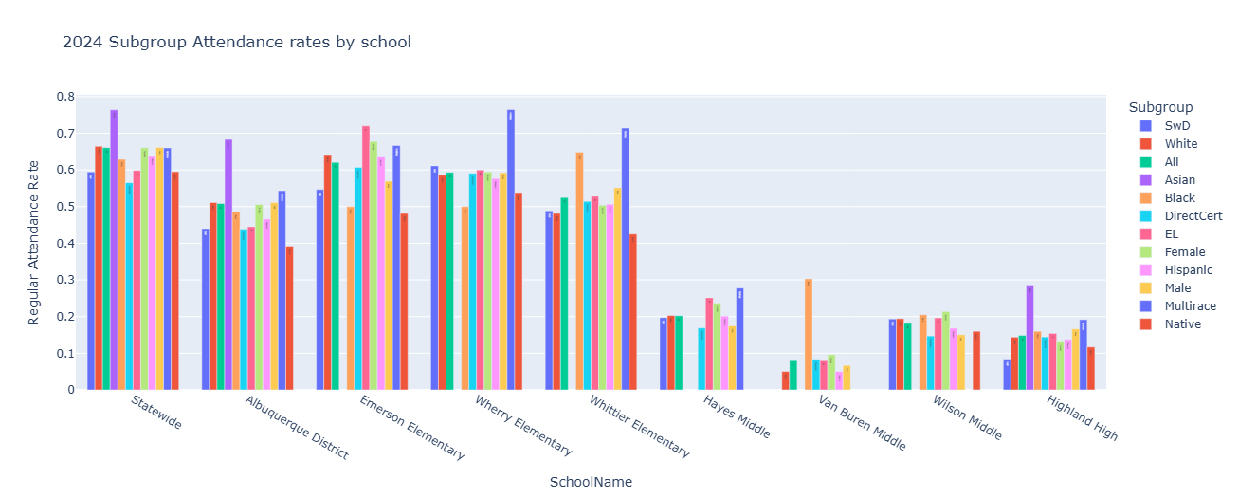
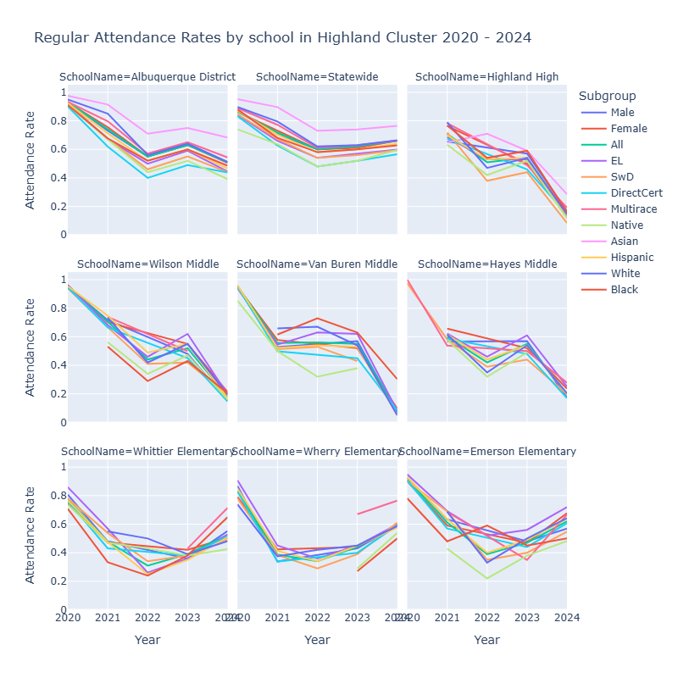
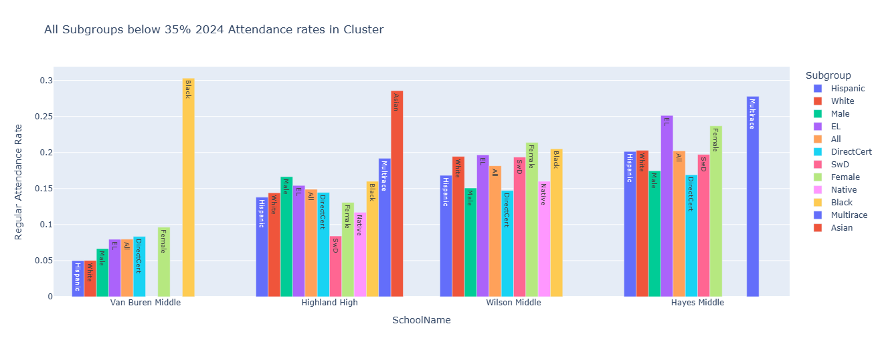
E
Attendance Trends in Highland Cluster
Notes:
Our team obtained student performance data from the NM PED, courtesy of the Research, Evaluation and Accountability office and thus were able to look at some trends over the past 5 years for attendance rates. The rate itself represents the percent of students who are present over 90% of all class time. Students who miss 10% of class time are classified as chronically absent.
The pattern that jumped out to me was this dive and recovery pattern state-wide and with elementary schools, but not so much with the middle and high schools. Last year, something changed.
For a third party or school administrator, we could look at these bar charts and identify schools and subpopulations of schools that need the most support in attending, in comparison to the other schools in their cluster. This might also point to where in the flow of a student’s academic career they might be most at risk of becoming chronically absent and where programs, like those created by the Black Leadership Council, might be able to direct their resources and expertise.
So clearly, there is a dive happening at the middle and high school levels of this cluster. It mildly mimics what is happening at the district level, but its exaggerated, so the question is: Is this unique to this cluster or is this a pattern across the district?

Slide 7
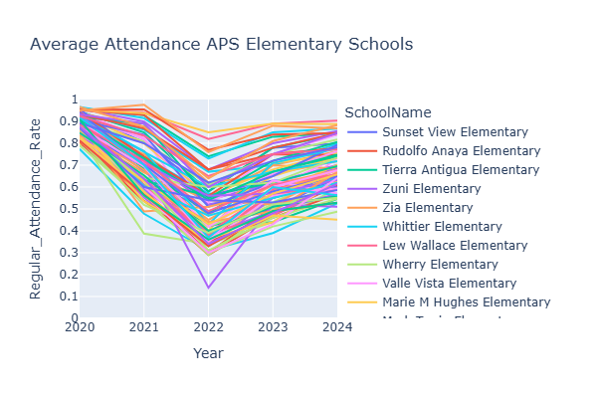
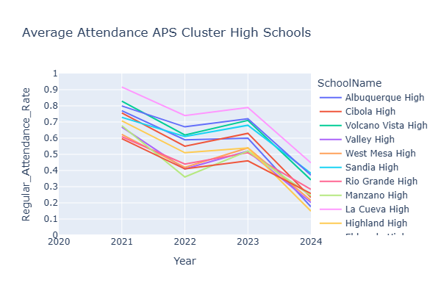
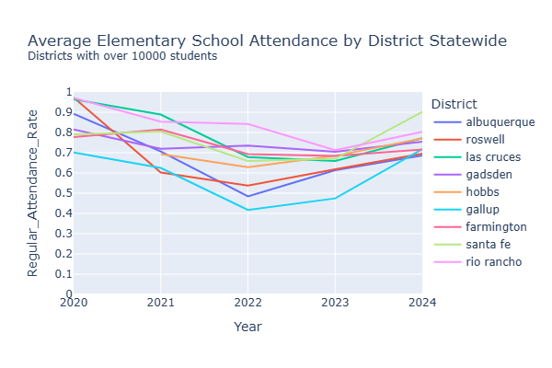
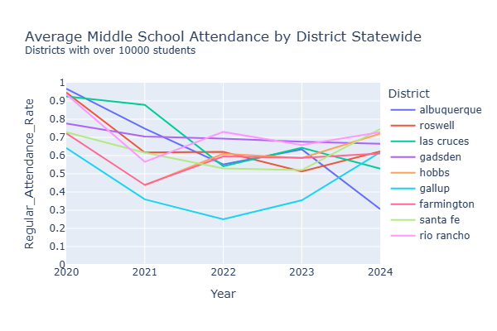
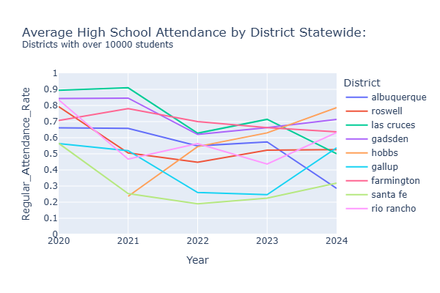
E
Comparing District and Statewide trends
Notes:
So we graphed all the average attendance of each school in APS by level. Here you can see the dip and recovery in elementary schools and same patterns for middle and high schools across APS.
But is this behavior happening statewide? There are many school districts in NM, some of which have less that 100 students for all school levels, so I chose to just compare to other school districts that had 10,000 or more students. The biggest school districts in NM are APS with ~70k followed by Las Cruces with ~24k and rio rancho with ~17k.
Elementary schools state wide seem to follow this trend but middle and high schools are harder to visualize a pattern but many, other than APS and Las Cruces, seem to be on a recovery path. Interesting thing to note and opens but many more questions.

Slide 8


Ty
QR Code to Map
Interactive Map
Legend
Incidents
7
Combined data points
Grocery stores
Data Sources
Notes:
Suggestions:
Sources become logos with links
Purpose Connecting Education & Accessibility, Highlighting Public Safety, Contextualizing Economic Conditions
Then sources
Then explain features with map open
Maybe explain this with the map open:
-Census tract: small, relatively permanent statistical subdivisions of a county; between1,200 and 8,000 people
-Food desert: Residents may have few, if any, supermarkets or grocery stores nearby; also often characterized by low income communities where even if the is one prices are prohibitive
Features: Combines color-coded school clusters with nearest grocery store details, blue-tagged grocery store locations, red-dotted police incident markers, median household income census tracts, and a heat map highlighting density clusters
Terms
Census tract: statistical subdivisions of a county; between1,200 and 8,000 people
Food desert: Residents may have few, if any, supermarkets or grocery stores nearby; also often characterized by low income communities where even if the is one prices are prohibitive

Slide 9
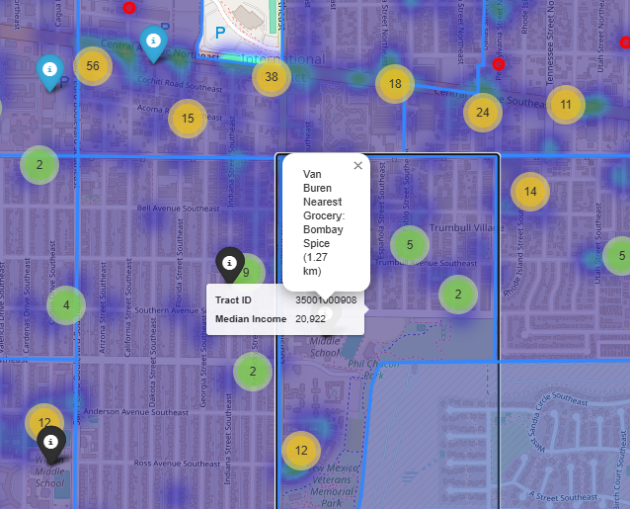
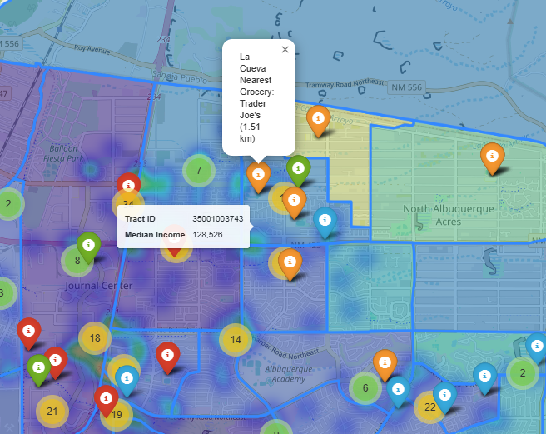
Ty
Comparing Schools on Map
Van Buren Middle on Map
La Cueva High on Map
Notes:
Suggestions:
Sources become logos with links
Purpose Connecting Education & Accessibility, Highlighting Public Safety, Contextualizing Economic Conditions
Then sources
Then explain features with map open
Maybe explain this with the map open:
-Census tract: small, relatively permanent statistical subdivisions of a county; between1,200 and 8,000 people
-Food desert: Residents may have few, if any, supermarkets or grocery stores nearby; also often characterized by low income communities where even if the is one prices are prohibitive
Features: Combines color-coded school clusters with nearest grocery store details, blue-tagged grocery store locations, red-dotted police incident markers, median household income census tracts, and a heat map highlighting density clusters
Terms
Census tract: statistical subdivisions of a county; between1,200 and 8,000 people
Food desert: Residents may have few, if any, supermarkets or grocery stores nearby; also often characterized by low income communities where even if the is one prices are prohibitive

Slide 10

Additional APS Data
Ti
From APS SAPR
Pupil-to-teacher ratio by school
Pupil count, teacher count, calculated ratio
Per-pupil expenditure by school
State and Federal spending
Precalculated by APS
Higher spending tied to needs (e.g. Title I)
Skills, Habits, and Mindsets Student Survey
Twice-yearly survey measures how students feel at school and how they deal with challenges
First administered 2023 -2024
5 categories: Perseverance, Self-Efficacy, Self-Regulation, Sense of Belonging, Social Awareness
APS Skills,Habits and Mindsets Survey

Slide 11
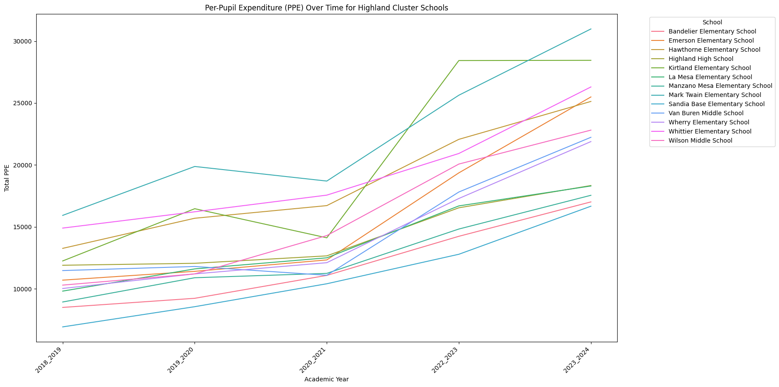
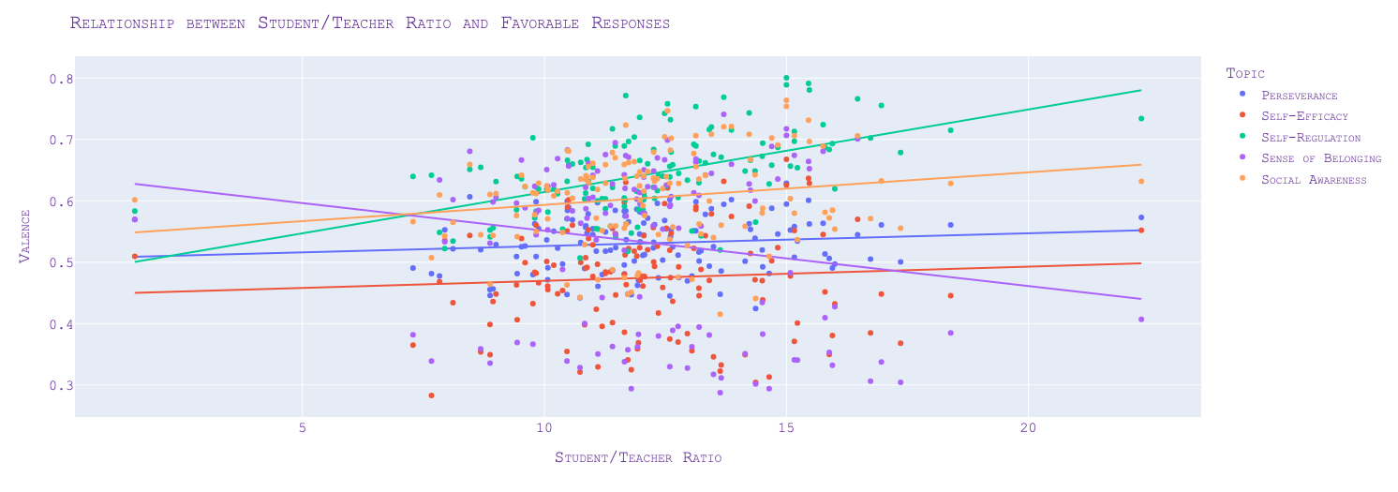
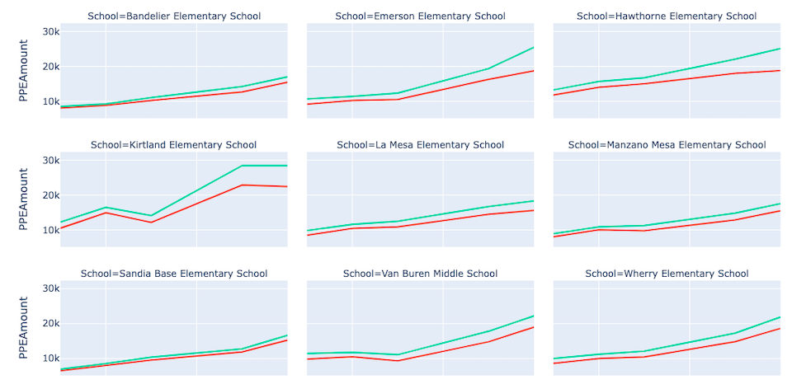
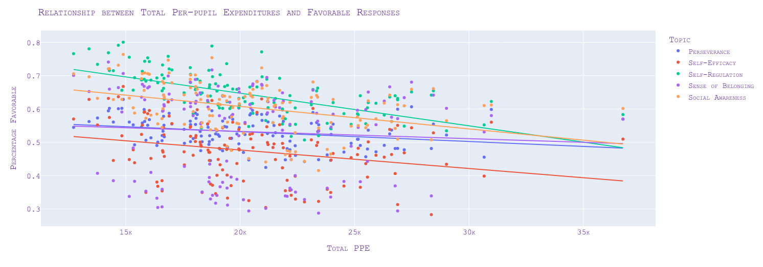

Ti
Survey Data, Per-pupil Expenditures, Student/Teacher Ratios

Slide 12
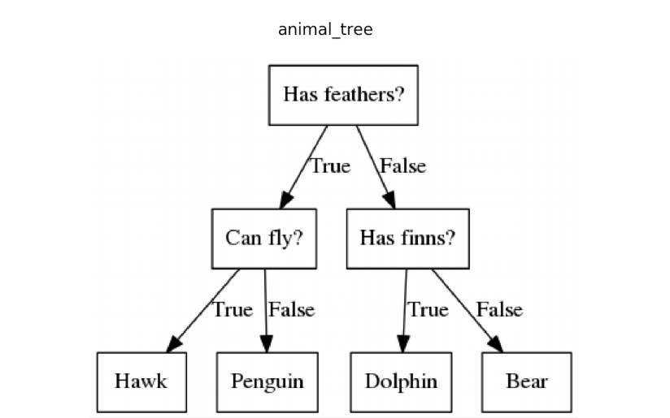
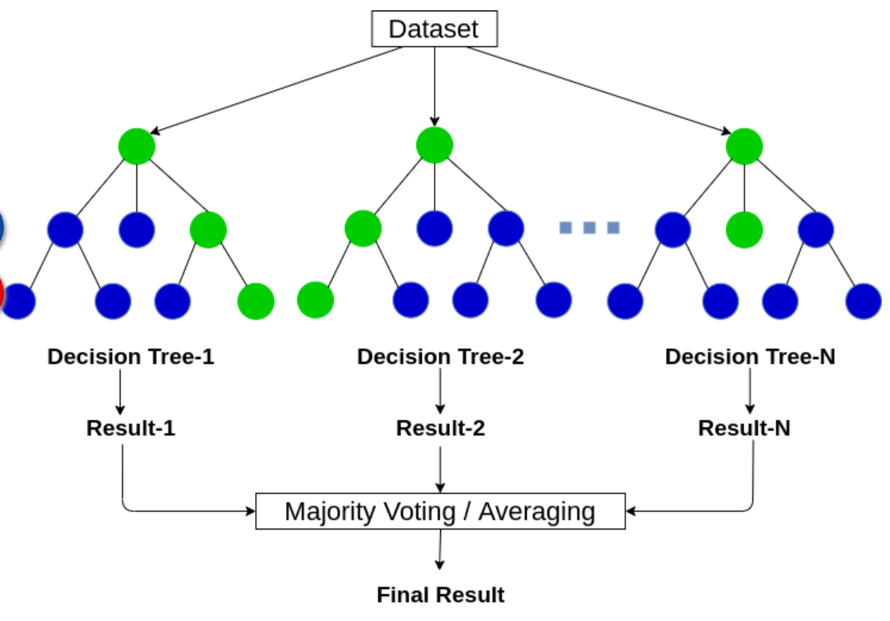
Decision tree
What is a model?
Random Forest
E
Mathematical representation of descriptive features that are used to classify or predict an outcome
Notes:
A decision tree is a series of true/false questions (kind of like 20 questions) to bucket data into similar categories.
A random forest model is the same but there are many runs of decision trees and the results are averaged.

Slide 13
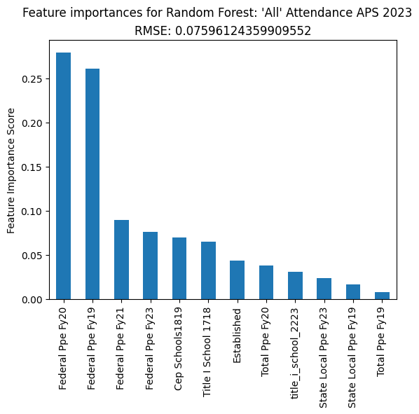
Random Forest
E
Data Source: APS SAPR
Goal: Create a predictive model of regular attendance rates based on individual school features
Features like …
Federal, state and Total PPE
School designation
(ABC, CEP, CSI, TSI, MRI)
Presence of bilingual program
Title I school classification
Census data
Acs Hs Diploma Or Less 2019 5Yr
Acs Median Household Income 2019
Notes:
We ran a random forest with 100 loops and max depth of 5 for features like funding, school designation, Title I classification to see if we could create a predictive model for average attendance rate for individual schools.
The cool thing about random forests if that you can see feature importance (which features influence the model more) and rank them. Of the huge list of features, each graph shows just the features that account for 90% of the model.
Features that showed up in 3 or 4 models
Federal Ppe Fy19 4
Federal Ppe Fy20 4
Federal Ppe Fy21 4
Fy19 Buget Enrollment 3
Federal Ppe Fy23 3
Total Ppe Fy20 3

Slide 14
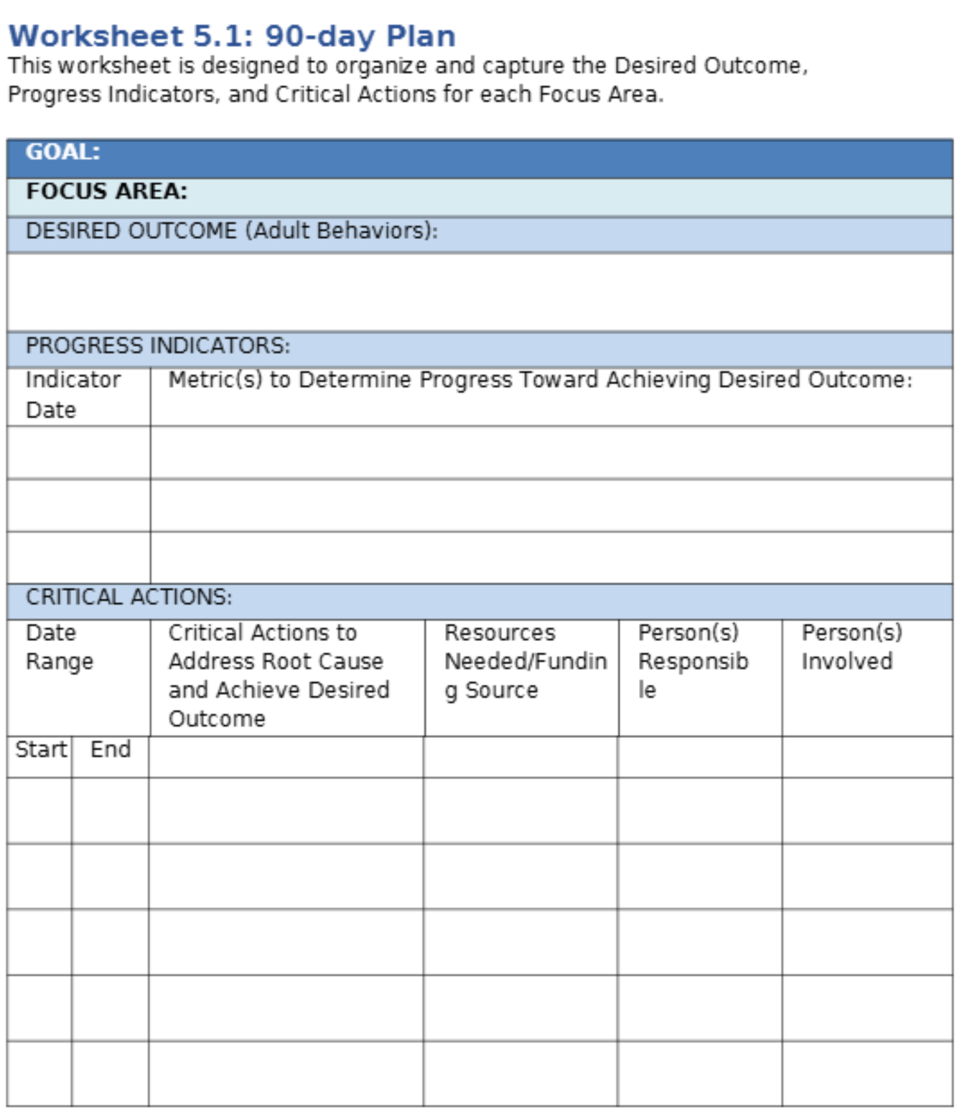
Launch point for future projects
Ti
Extensions of mapping
More descriptive analysis
Add zoning areas for schools
Calculate average census data per zone
Add community resources and infrastructure locations and frequencies per zone
analysis of clusters of schools across APS or state
different performance metrics: graduation and proficiency data
NLP of 90 day plans
Notes:
We barely scratched the surface of a multi-phase research project. From here, this project could launch many new directions.
We could add school zoning areas on to the interactive map to calculate more accurate census averages or add other community resources like medical services and transportation for an infratturce base community needs analysis.
The research we did on clusters of schools could be extended to every feeder cluster in APS or in the state. We could add other proficiency metrics like graduation and proficiency data (which we have, but didn’t have time for).
We could create a Natural Language processing model to analyze school responses to needs called a 90 day plan to see if school sites are actually addressing their biggest needs.

Slide 15

Acknowledgements
Ty
Notes:
Thank you so much to: New Mexico Black Leadership Council, APS Strategic Analysis & Program Research Department, PED Research, Evaluation, and Accountability Bureau
For collaborating with us for vision, guidance and data access.

Slide 16






Thank you!
Questions?
Ty
asdf
Tyre’ Beard
Tim McKee
Emily Walukas
To access:
Interactive map
Attendance graphs
Social emotional habit survey result visualizations
Per Pupil Expenditure (PPE) graphs
LinkedIn
LinkedIn
LinkedIn
Notes:
And thank you for listening.
We now have a few minutes for questions

Slide 18
Main learning opportunities (obstacles)
Ty
Readily available but Formatting (long vs. wide, column labels vary by year)
Maturity of data (presented in csvs instead of a public API)
Data dictionaries and lack there of and lots of educational industry definitions
Census.gov API Shutdown: Updated security policy halted API access, requiring a switch to the FTP server
ArcGIS/Public/APD/Incidents: server is currently unavailable, disrupting access to police incident data.
Masking for the populations we were most interested in

Slide 19
Data analysis process
Ti
New Problem Definition
Problem Definition
Understand the project's objectives from a business viewpoint.
Data Collection
Gather relevant data. If data are already available, understand how data were collected.
Data Cleaning & Exploratory Data Analysis
Understand, clean and explore data.
Processing
Use modeling techniques to gain useful insights into data and meet objectives of the project.
Communication of Results
Communicate results of analysis. Draw meaningful conclusions.
Notes:
Define Questions
Interesting and actionable for NMBLC
Data is available
Fits within available project time
Consult with Subject Matter Experts
NMBLC
NMPED Research, Evaluation and Accountability
APS Strategic Analysis & Program Research
Retrieve data
Direct requests to agencies for files
Download from agency portals
Manually
Web scraping
PDF Parsing
Organize and clean data
Nulls, multiple data types in single columns, non-numeric data
Contents and formatting of data different between years
Bring separate datasets into centralized datasets or analysis

Slide 20
asdf
Tyre’ Beard
Tim McKee
Emily Walukas
LinkedIn
LinkedIn
LinkedIn

